Slide 1

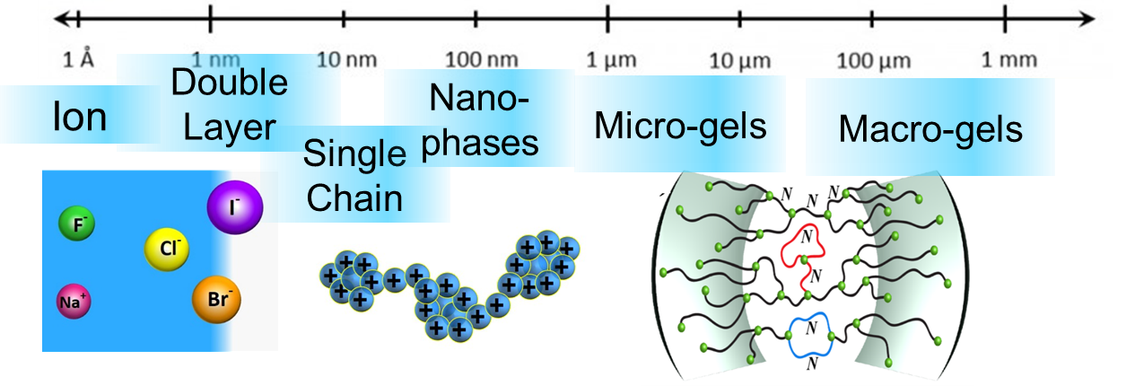
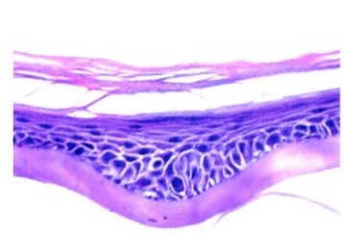
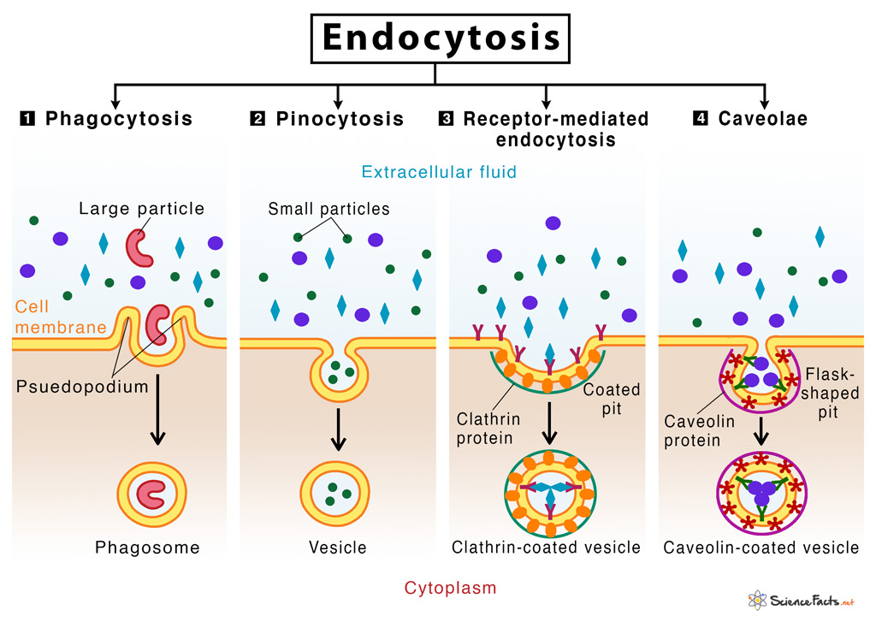
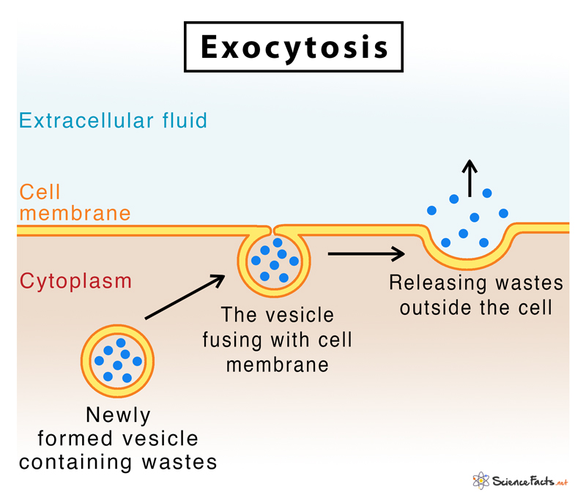
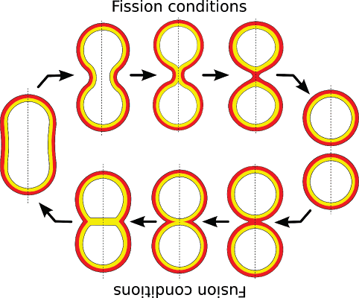
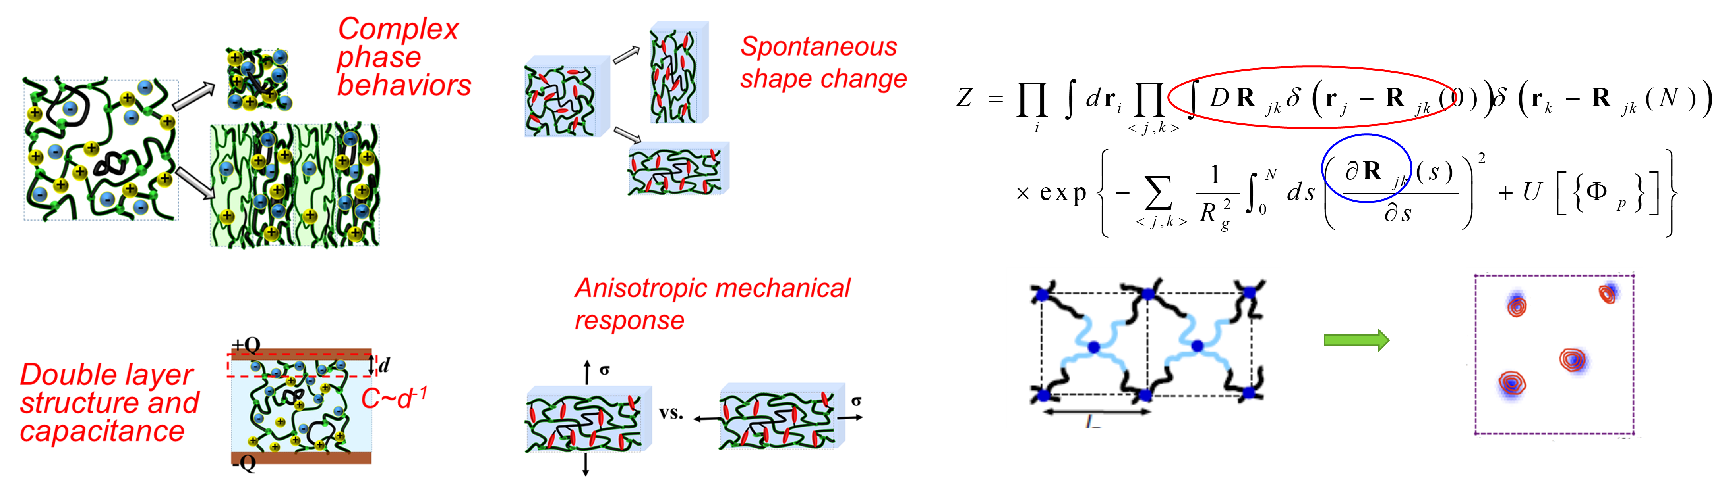
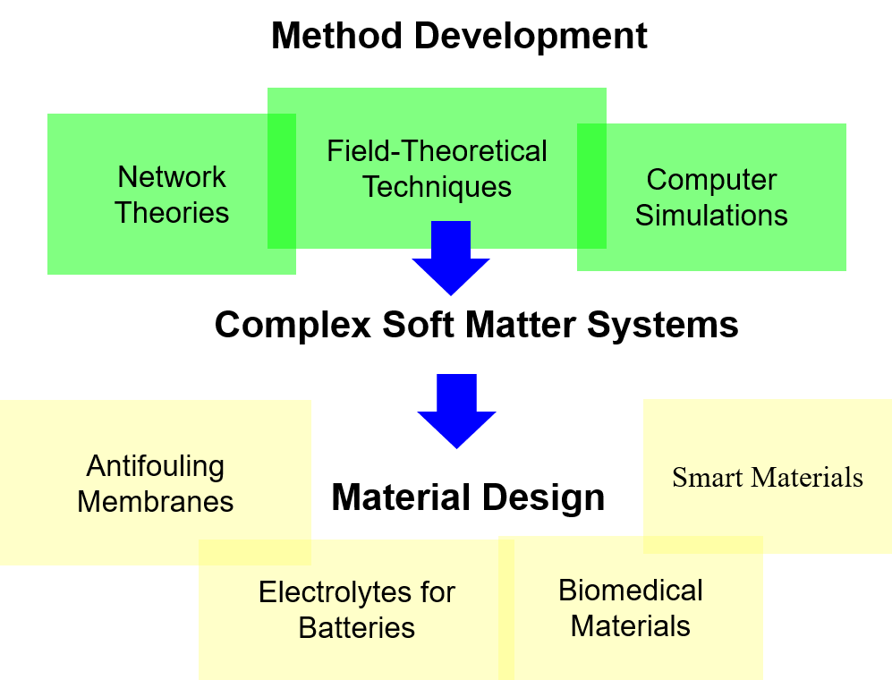
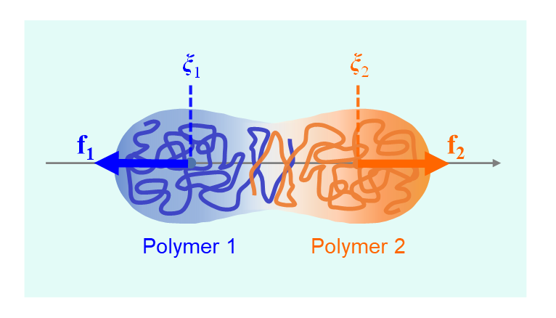
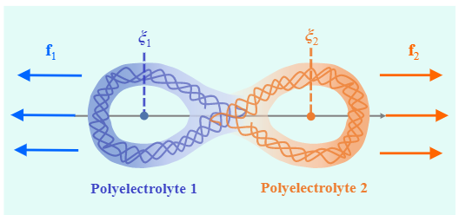
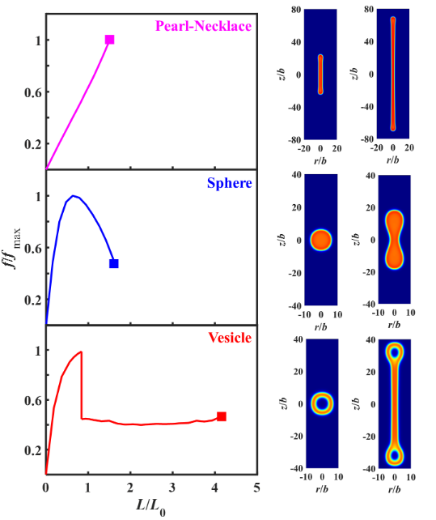
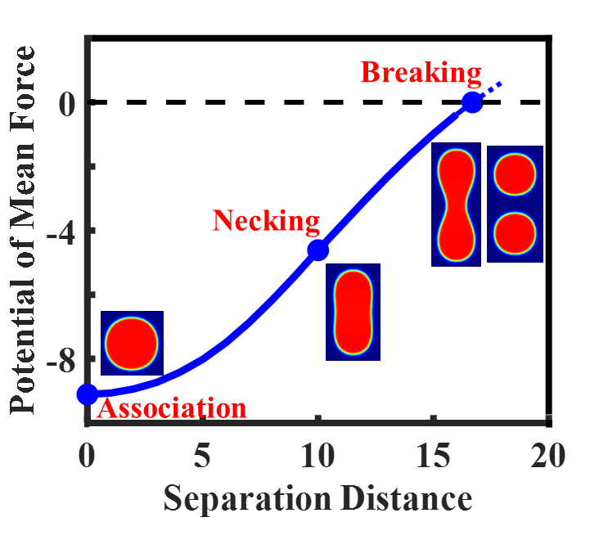
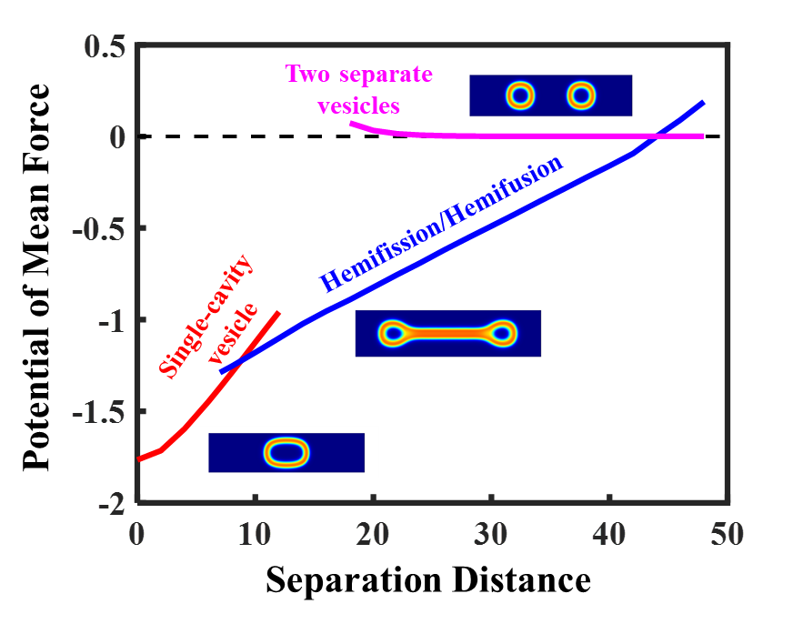
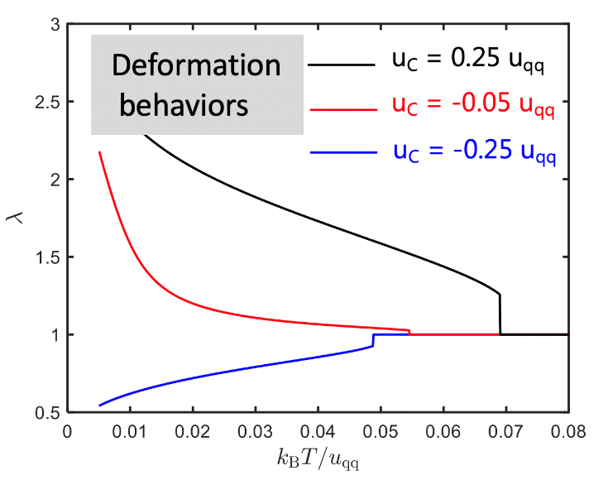
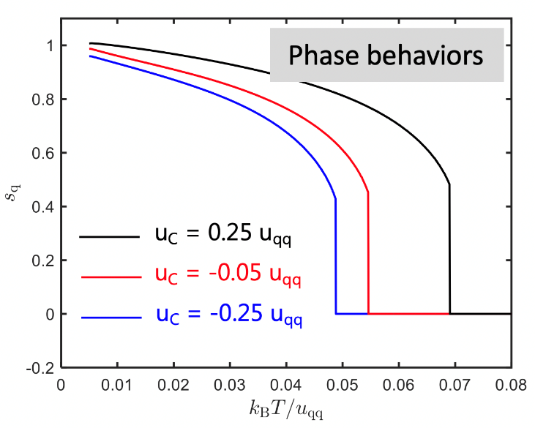
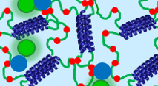
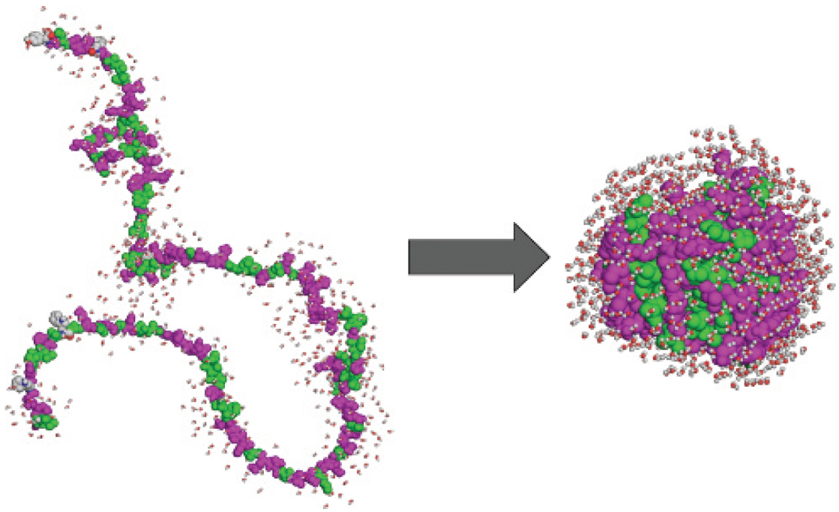
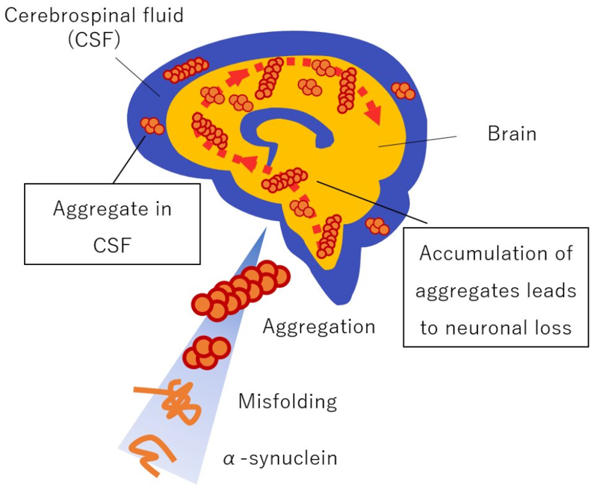
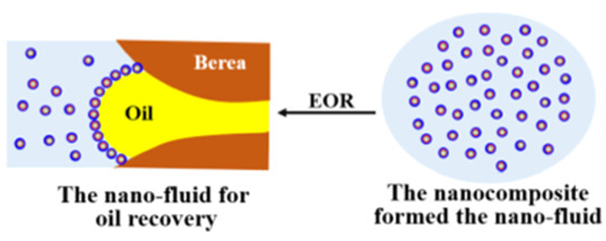
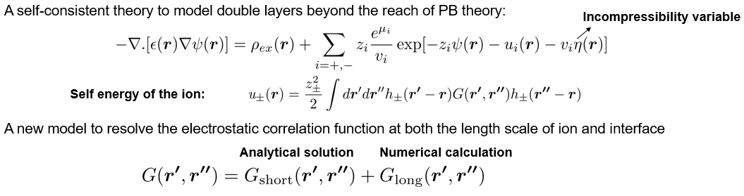
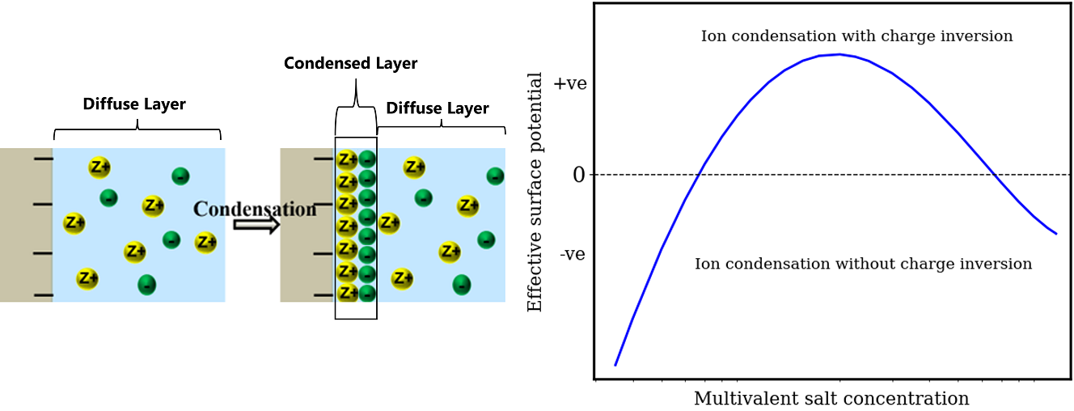
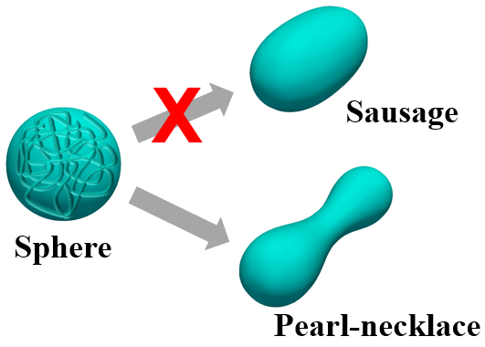
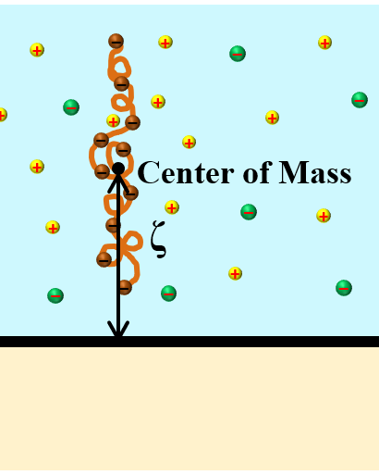
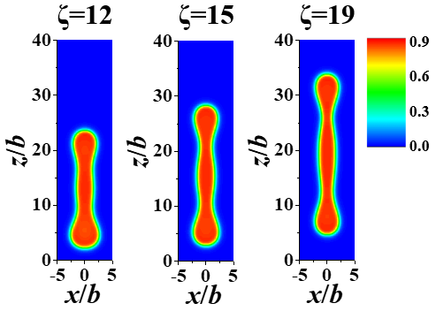
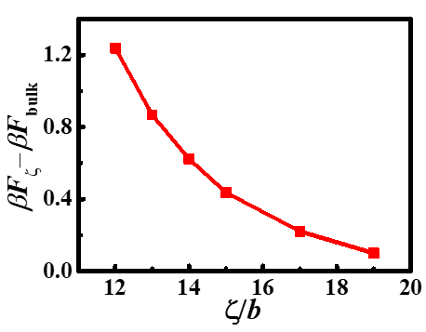

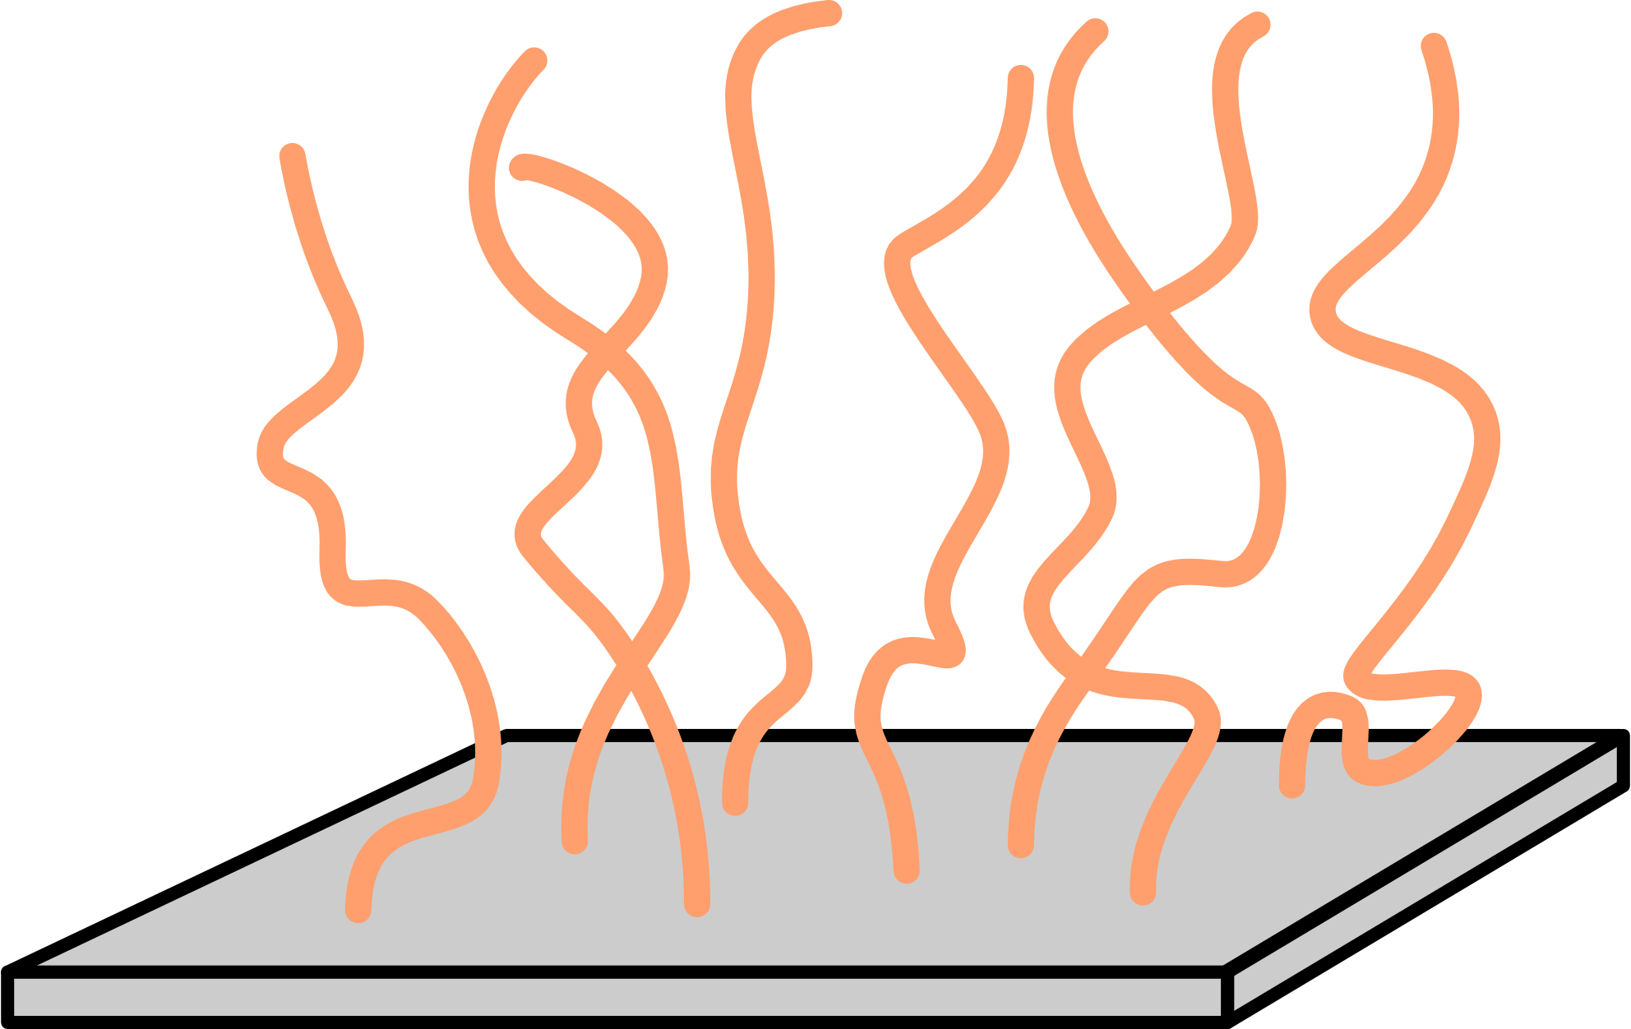
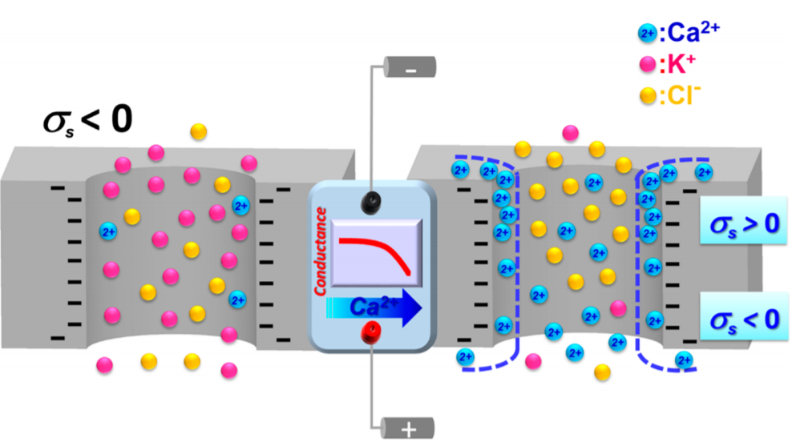
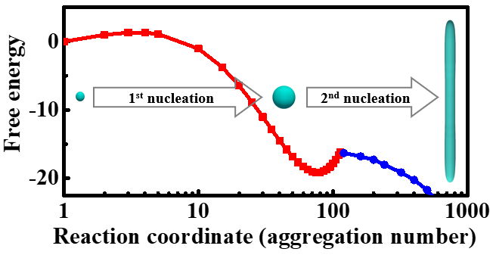
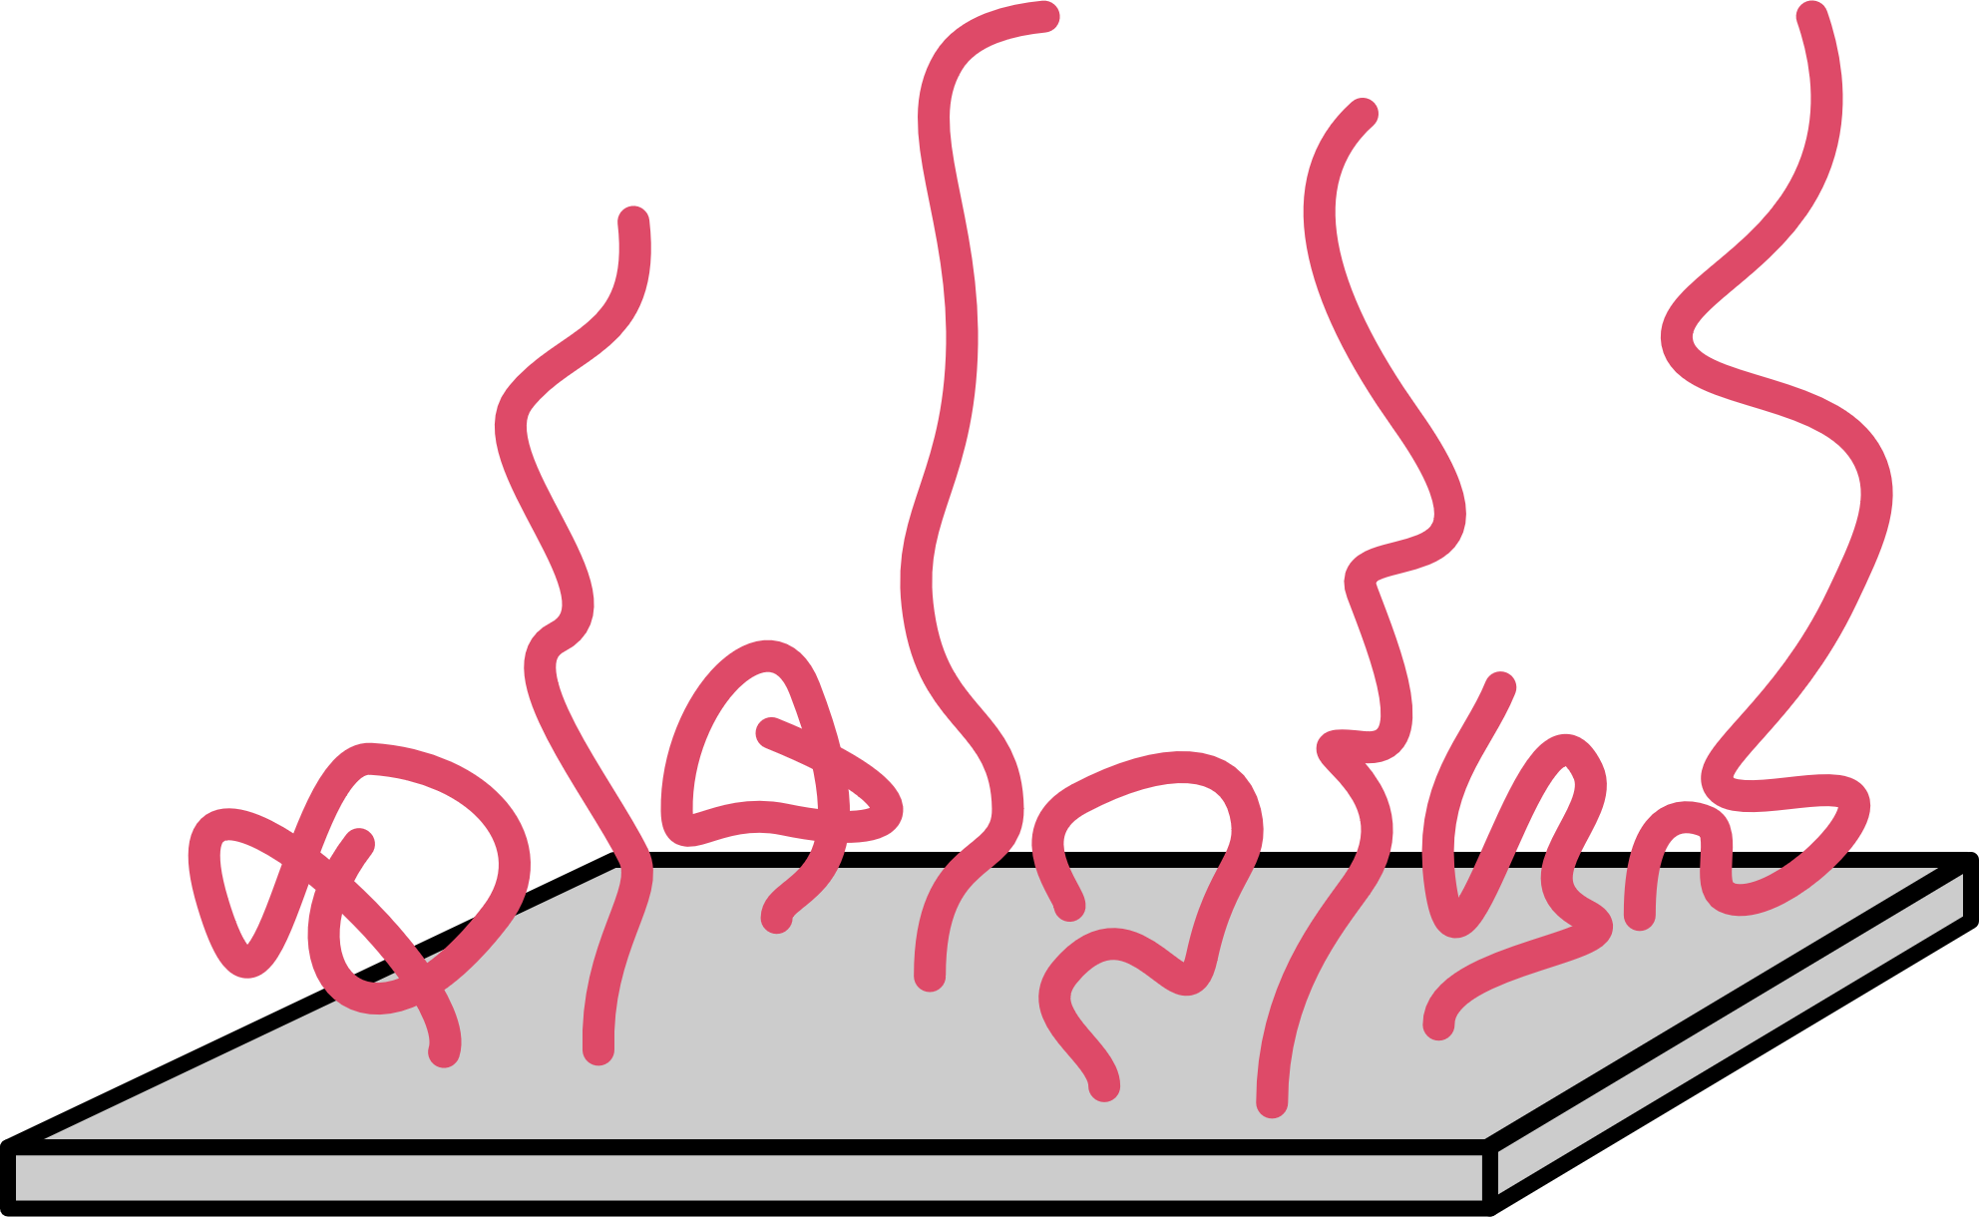
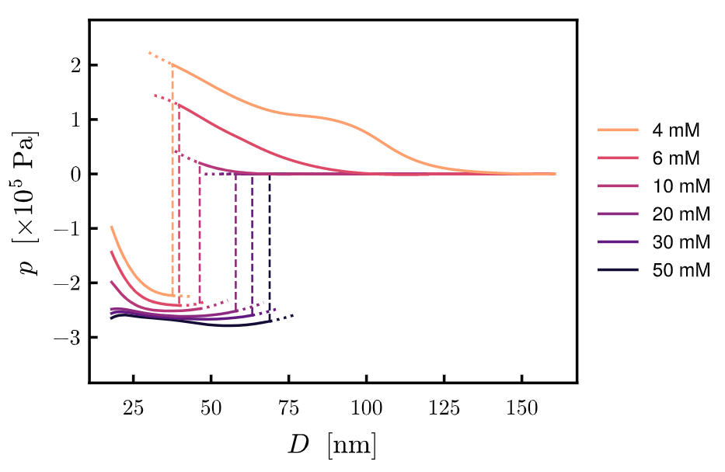
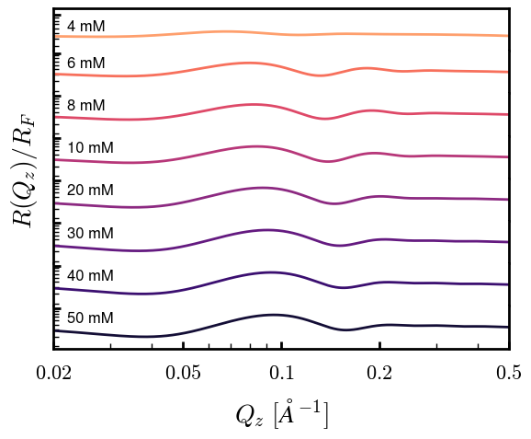
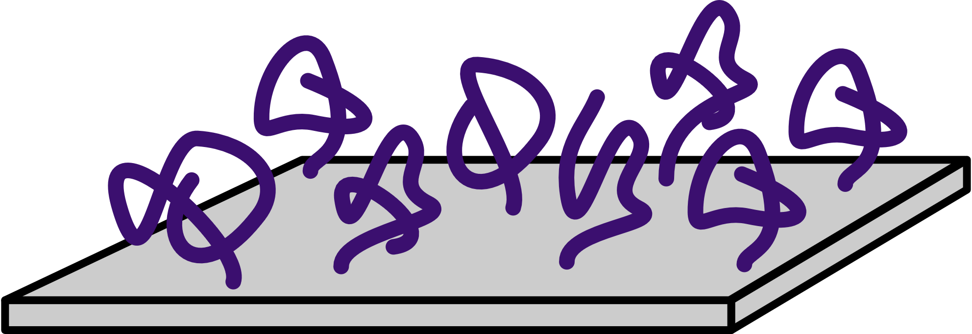

Theoretical Polymer and Soft Materials in the Wang Group
Department of Chemical and Biomolecular Engineering, College of Chemistry, UC Berkeley
Principal Investigator: Prof. Rui Wang; ruiwang325@berkeley.edu
Wang Group Theme
Complex Polymer Networks: Towards the Design of Smart Materials
Polymer Interactions, Morphological Evolutions, and Micromechanics
Ions, Polymers, and Gels
Motivation: Stimuli-responsive materials
Motivation: Vesicle Fission and Fusion in Cells
Sensors
Artificial muscles
Soft Actuators
Ionic Gels
Liquid Crystal Elastomers
Neutral Polymers
Polyelectrolyte Vesicles
Micromechanics
Challenges:
Wide range of length scales
Multiple components and interactions
Inhomogeneous system with interfaces
Retention of molecular information
Complex phase behaviors
Biopolymer Networks
Topology
Elasticity
Permittivity
Structure and Dynamics of Polyelectrolytes
Ion Solvation and Transport in Polymer Electrolytes
Electrostatics at Interfaces of Membranes and Ion-Channels
Motivation: Polyelectrolytes are everywhere
Motivation: Rational Design of Polymer Electrolyte for Li Batteries
Motivation: Membrane Fouling Driven by Electrostatics
Objective: Relating microscopic solvation structures to continuum electrolyte transport
Method: Computer simulations
Collaboration with experiments
Protein Folding
Protein Aggregation
Enhanced Oil Recovery
Unusual Solvation Behavior
Method: A new field-based polymeric theory
Electrostatic correlation induced ion condensation and charge inversion
Single-chain Conformation
Interfacial Activity
Stable vesicle
Conformation
Image Repulsion
Ion Transport via Correlated Motion
Applications
Nucleation in PE Aggregation
PE Brush
Ionic Strength
Conformation
Predicted Characterization
Encapsulation of DNA in viruses
Electrokinetic Flow in Nanochannels

